Slide 1
CSSE220 Resolving Merge Conflicts In Eclipse EGit
Notes:
We want to introduce roles, answer questions, and then let them work on their project and meet with their TA.

Slide 2
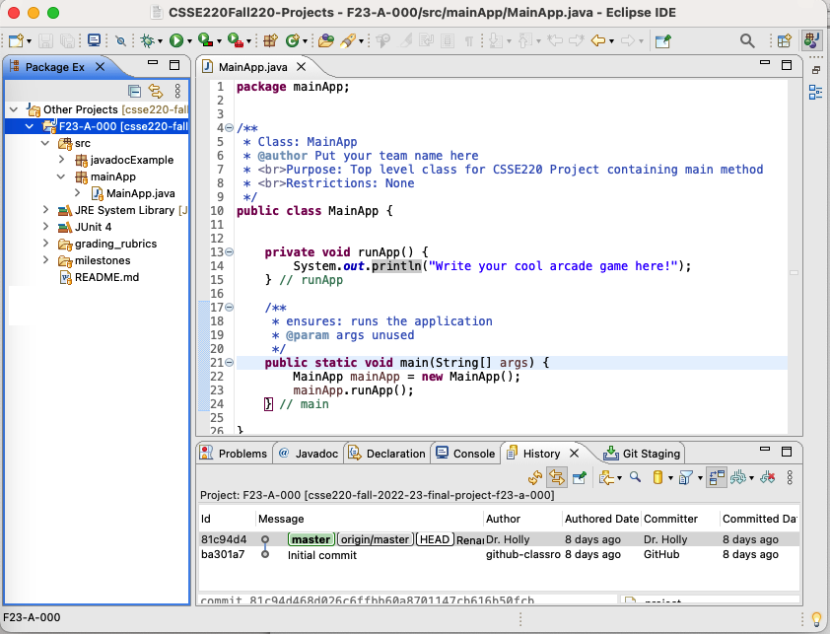
Project F23-A-000 Under Git Source Control

Slide 3
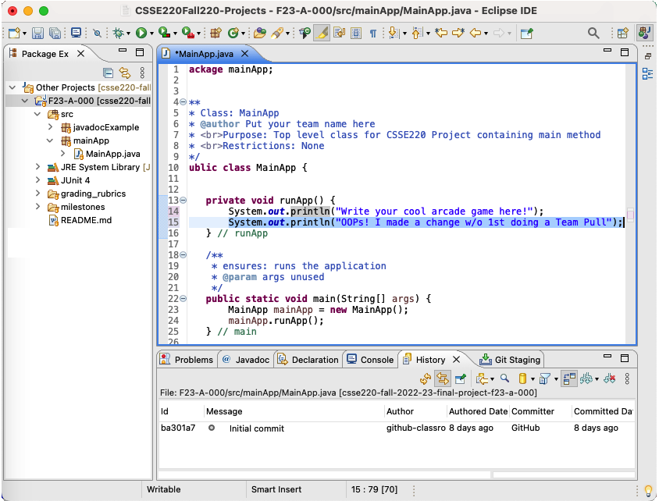
A Change/Edit Before Doing a Team Pull

Slide 4
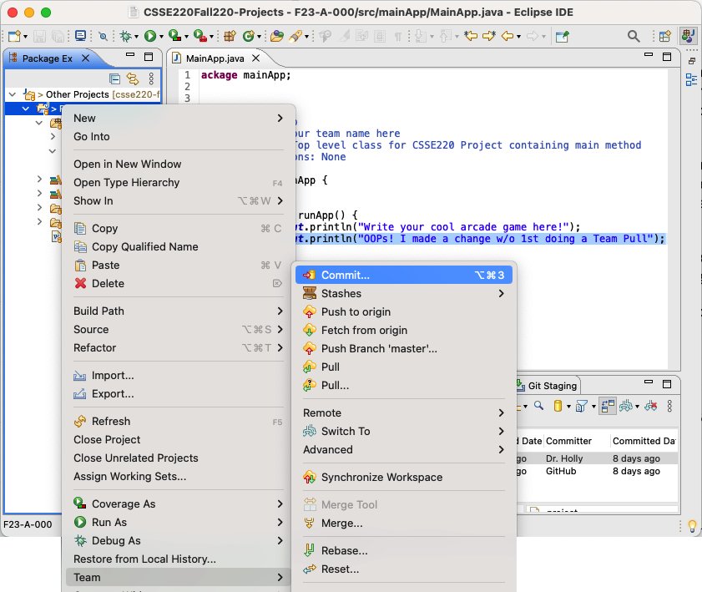
Ready to Push Changes – 1st Do Team Commit …
1) Right click the project
2) Choose Team > Commit…

Slide 5
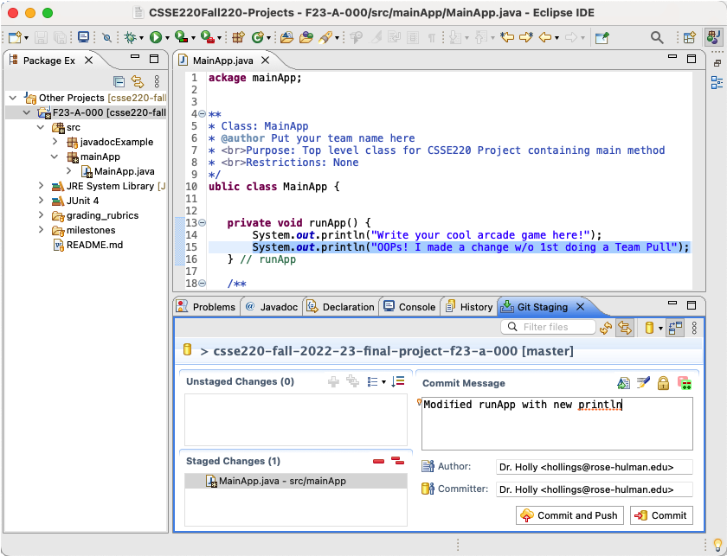
Finish the Commit
Provide a
commit message
2) Click Commit

Slide 6
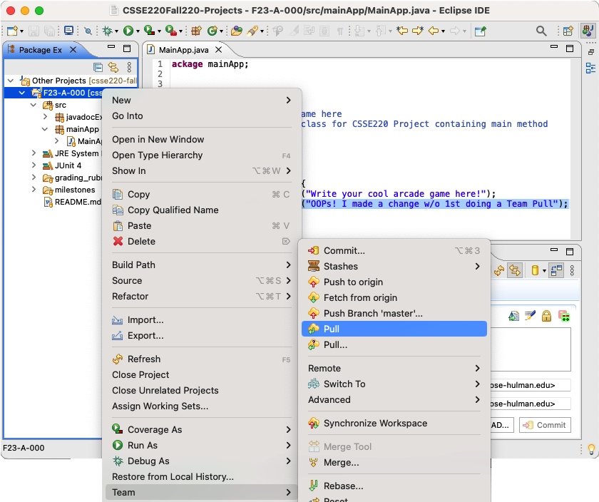
Now (after the Commit) Do a Team Pull
1) Right click the project
2) Choose Team > Pull

Slide 7
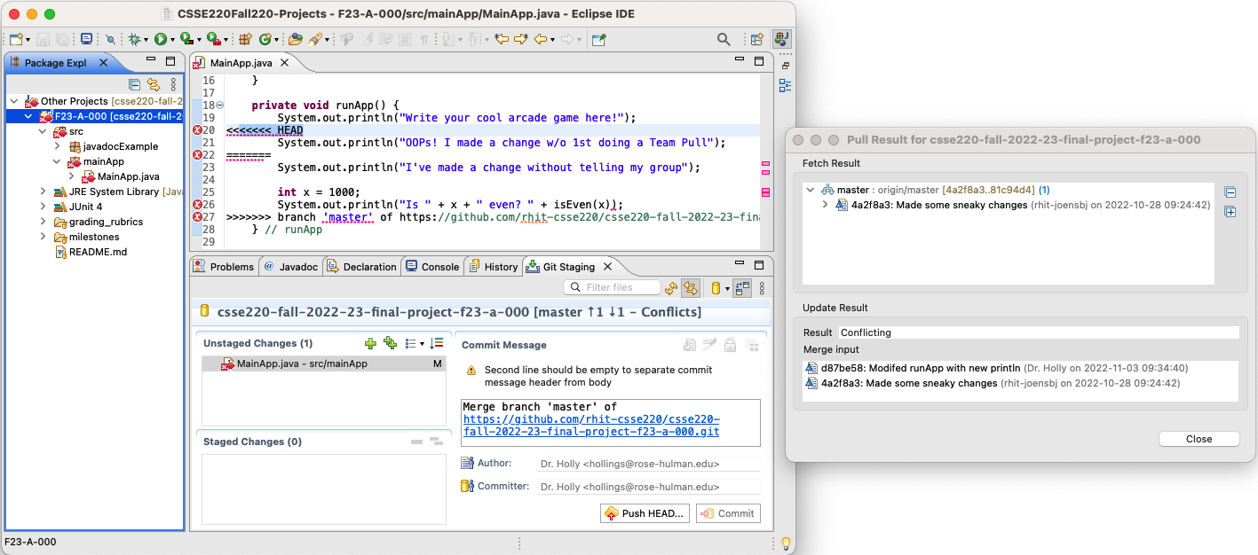
Oh-oh a Merge Conflict

Slide 8
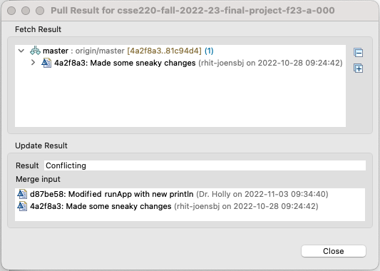
Interpreting the “Pull Result” Dialog
The Pull Result dialog appeared when we executed the Team Pull
The Result is “Conflicting”
The Merge input section shows 2 previous commits that must now be merged
Git determined there was a conflict by comparing this local code base to the code base up in the shared repo

Slide 9
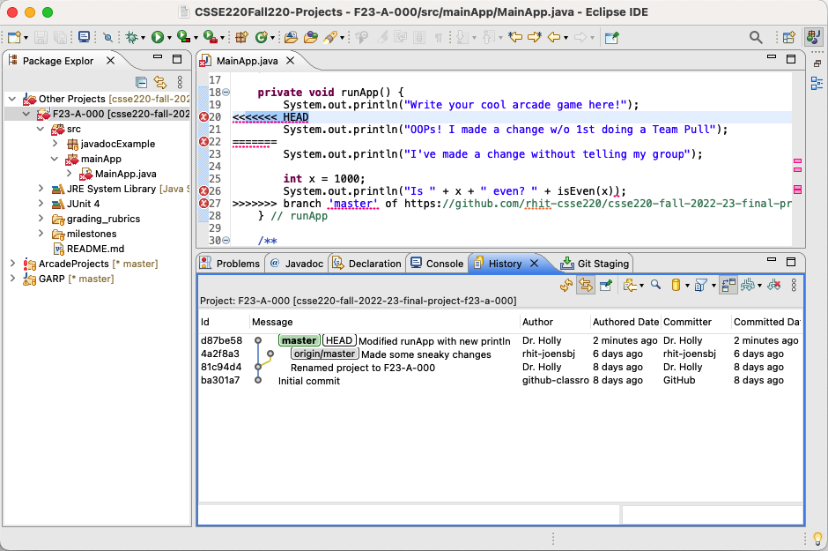
A Look at the Commit History
By clicking the git History tab, we can see the commit history
And the two previous commits that must be merged

Slide 10
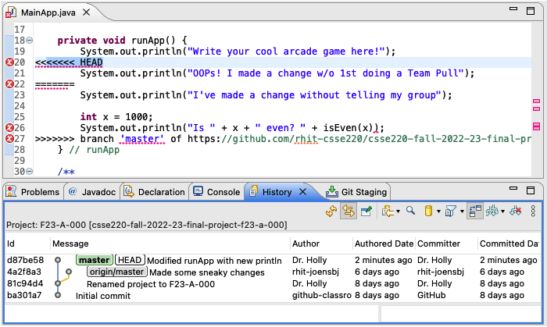
Git Inserts Two Code Chunks
HEAD code chunk
origin/master code chunk from the other branch
Your job is to merge these two chunks of code

Slide 11
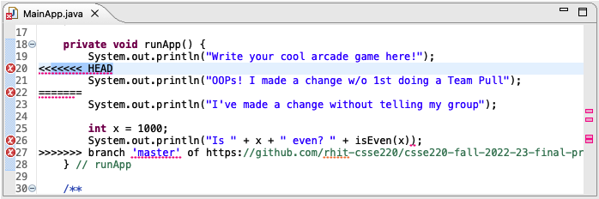
Types of Code Chunk Interference
Types of Interference:
No interference, i.e., each code chunk does its own thing independent of the other chunk
They interfere, i.e., something that one code chunk does causes problems with the other chunk
How to merge:
If there is no interference, then just make sure both chunks of code are included in the final merge
If there is interference, then you must read and understand what both chunks are doing and find a way to produce a merged version that has the correct functionality
In the example above:
There is no interference

Slide 12
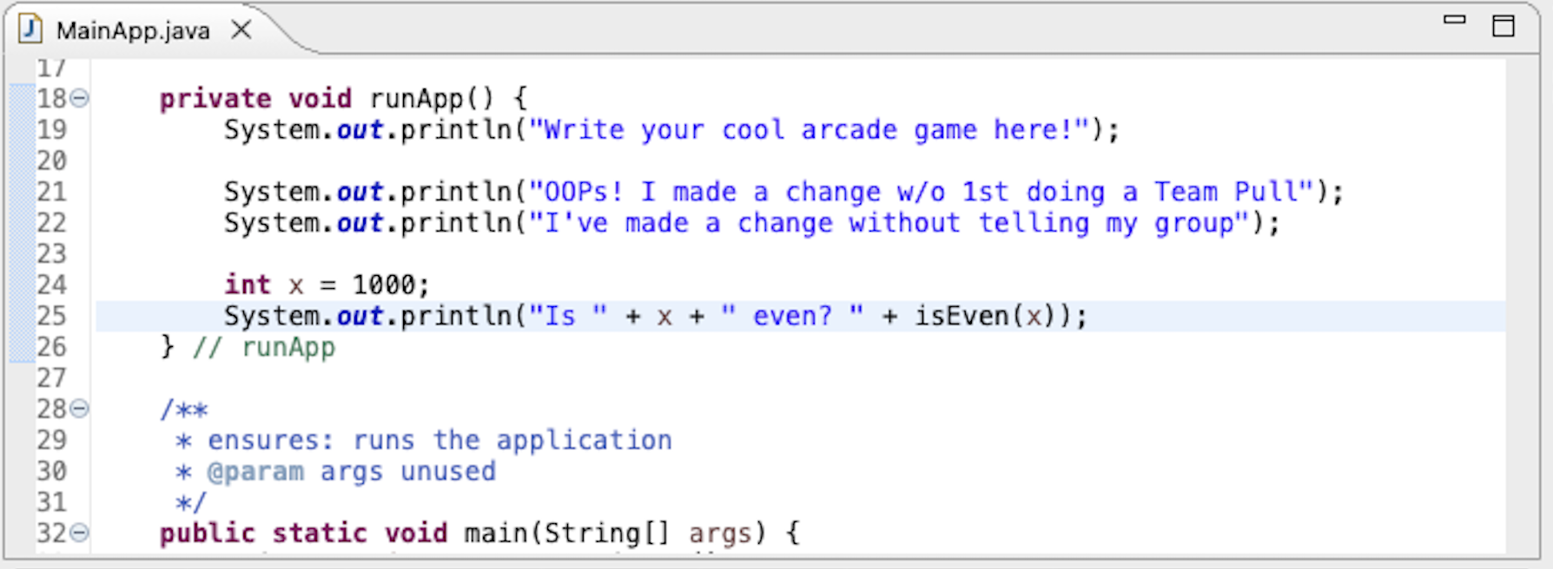
After Merge
In this contrived example:
We assumed no interference
We merged code from the two branches
Next comes pushing the changes

Slide 13
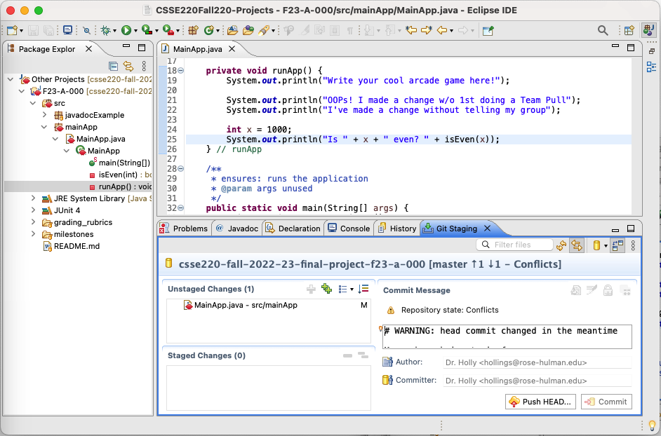
MainApp.java is an Unstaged Change
Click back to Git Staging tab
Notice that the MainApp.java file is listed as an Unstaged Change

Slide 14
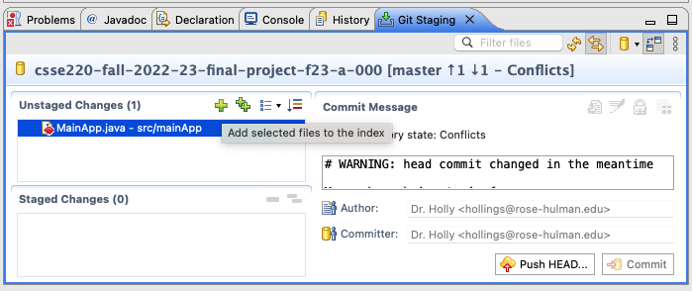
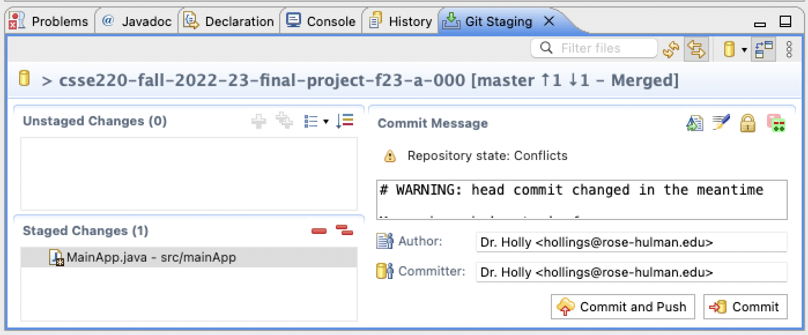
Make MainApp.java Staged & Then Push & Commit
Click the unstaged file to select it
Then click the This will move the file to Staged Changes
Now MainApp.java has been Staged for Commit and Push

Slide 15
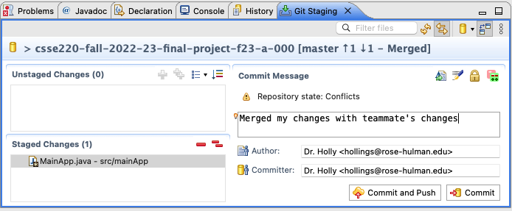
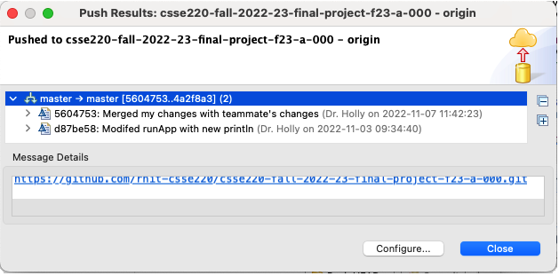
Make MainApp.java Staged
Enter your commit message
Then click Commit and Push
A Push Results dialog will appear showing the results

Slide 16
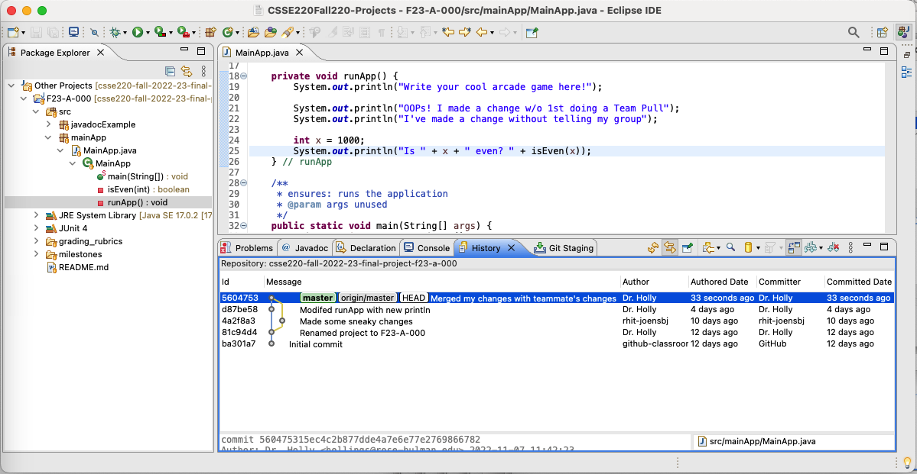
The Merge Conflict is Resolved
Click back to History tab
And you will see that your two branches have been merged back into one
Merge conflict resolved

Slide 17
Additional EGit/Eclipse Details
Notes:
We want to introduce roles, answer questions, and then let them work on their project and meet with their TA.

Slide 18
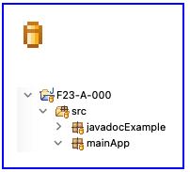
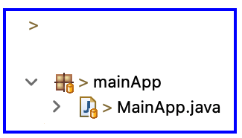
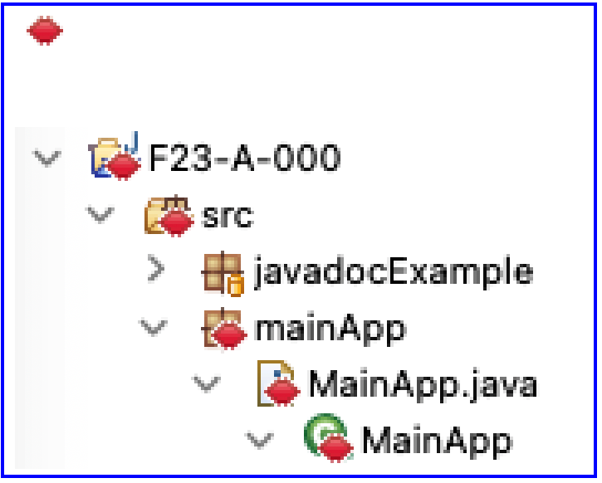
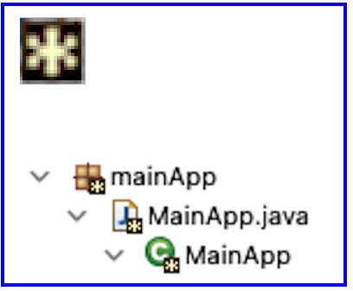
Understanding EGit Icon Adornments
Under Source Control adornment
Merge Conflict adornment
Dirty adornment, a modified tracked file
Staged adornment

Slide 19
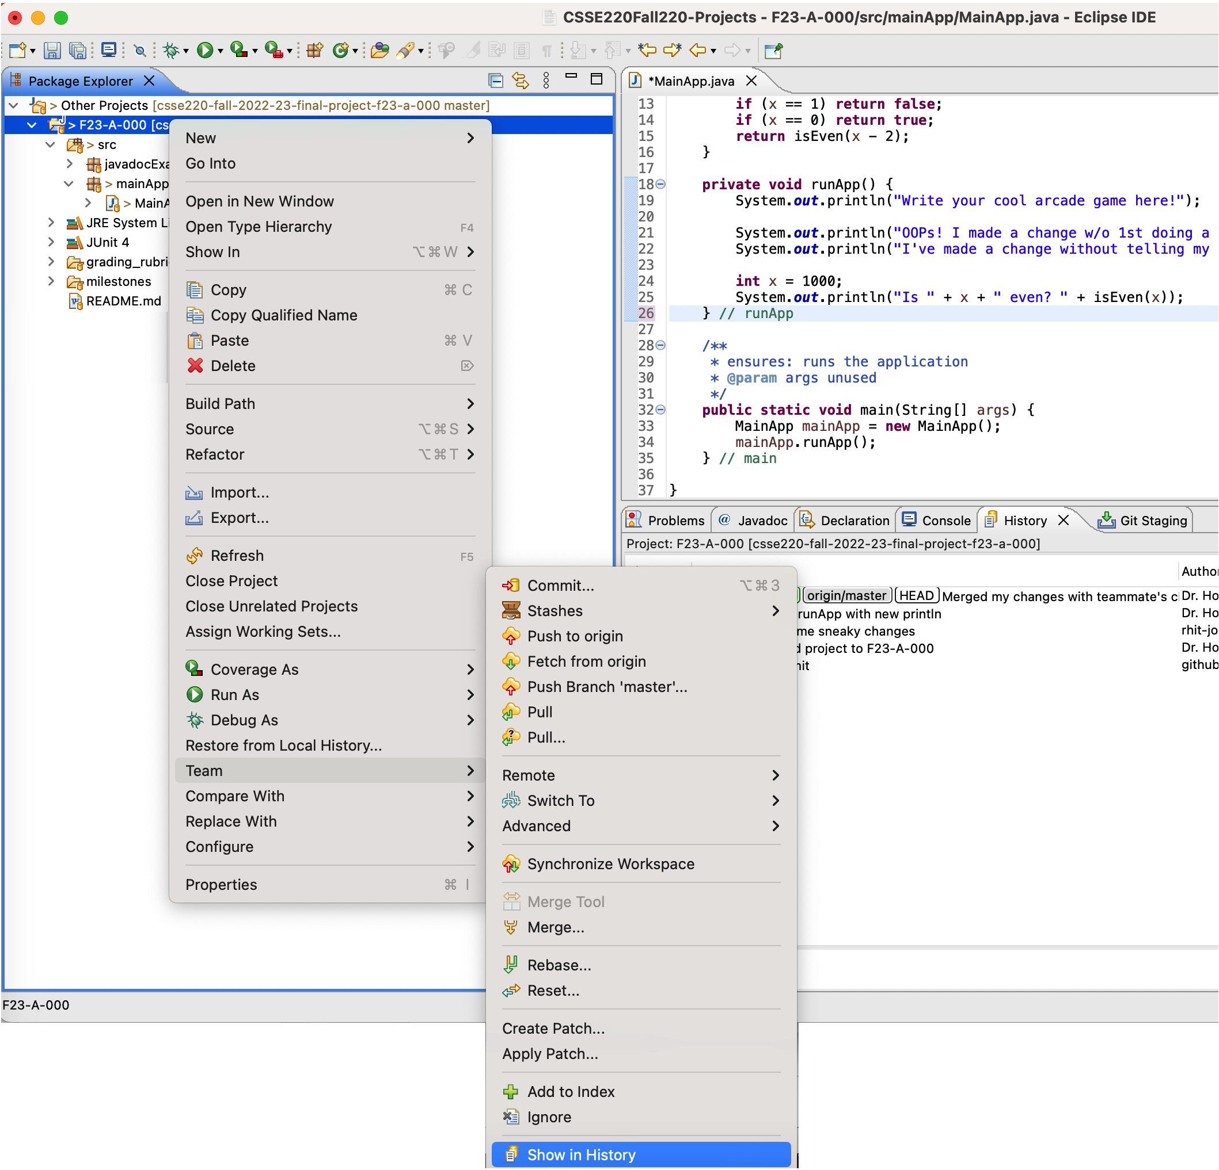
How to View the History Tab
1) Right click the project
2) Choose Team > Show in History …

Slide 20
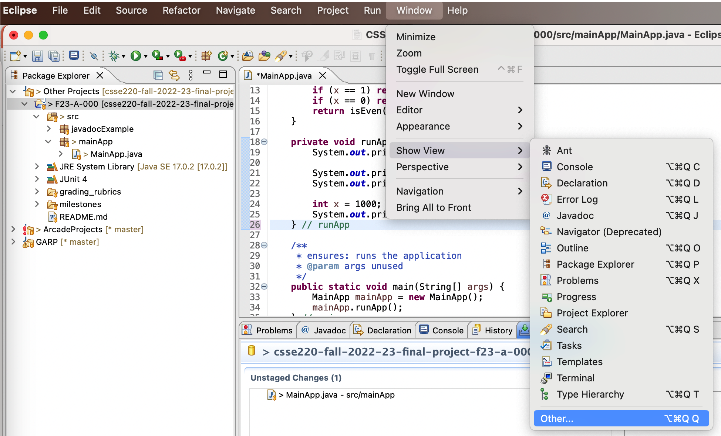
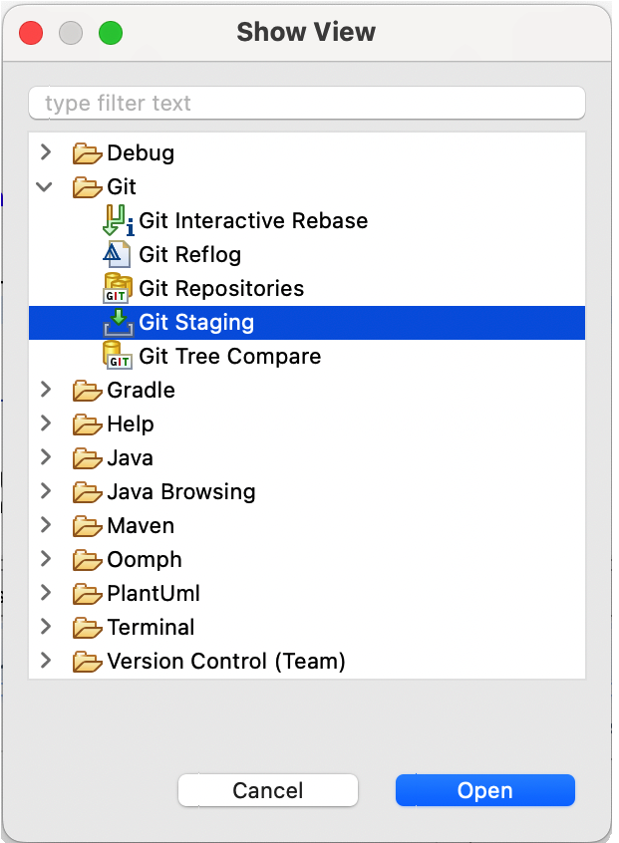
How to View the Git Staging Tab
Click Window > Show View > Other…
From the Show View dialog Choose Git > Git Staging

